Slide 1
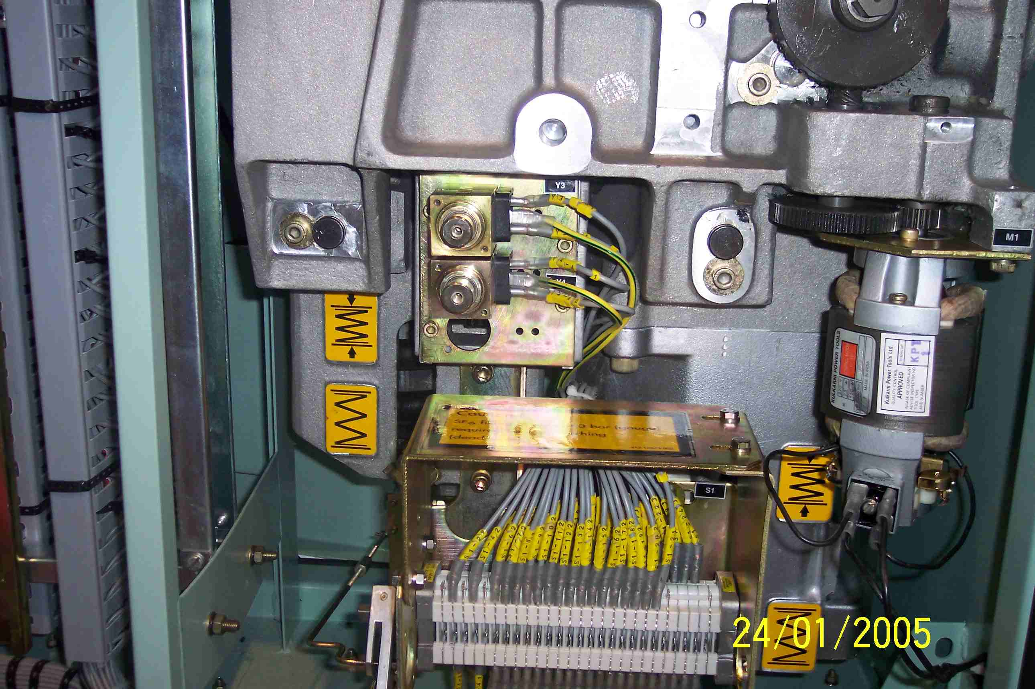
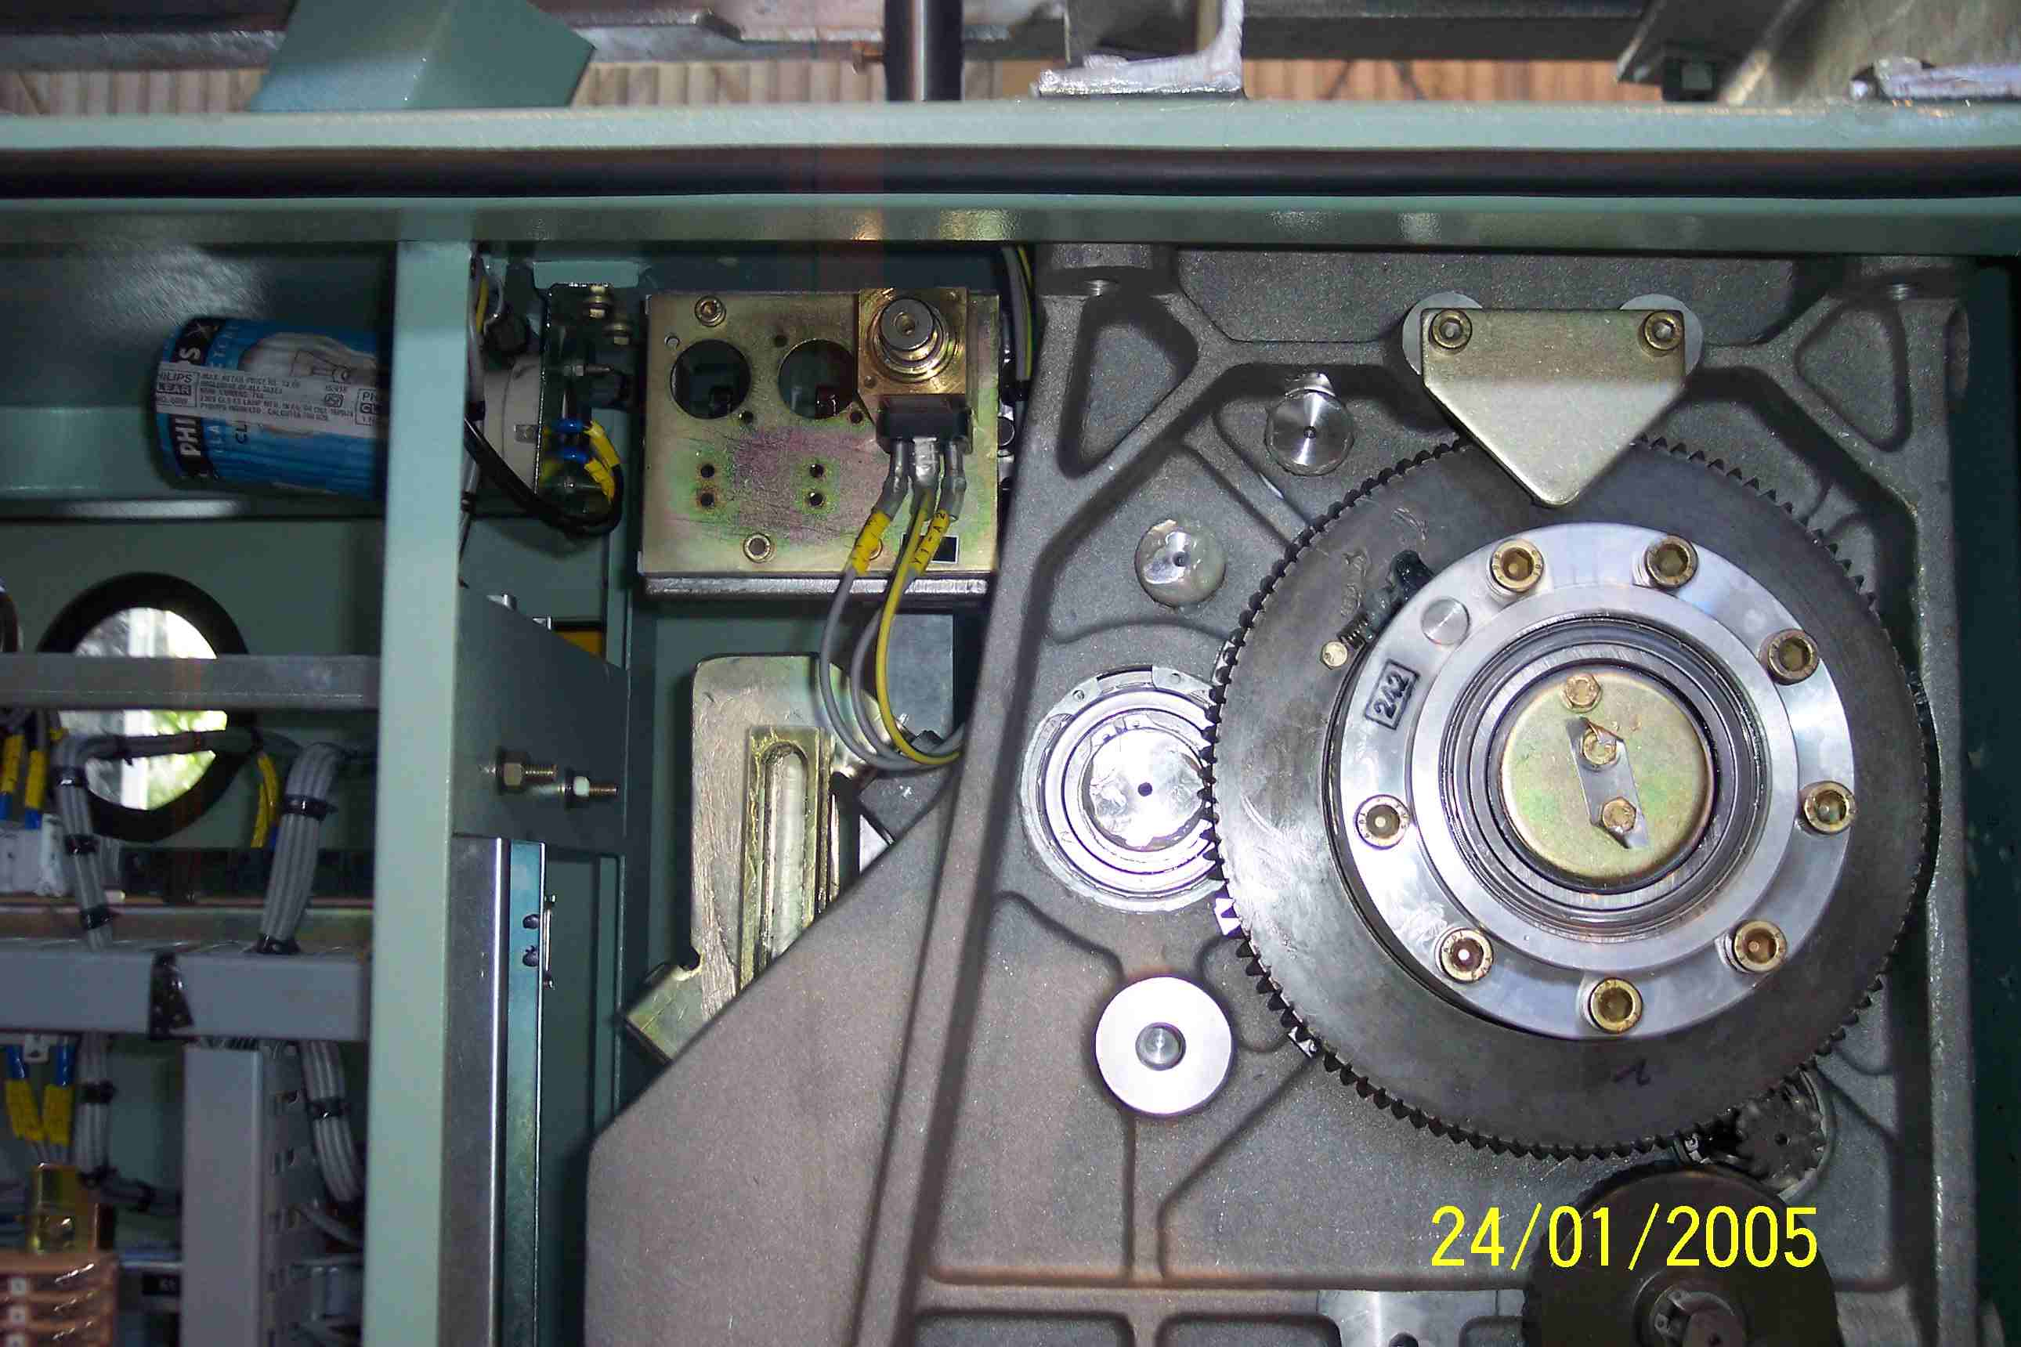
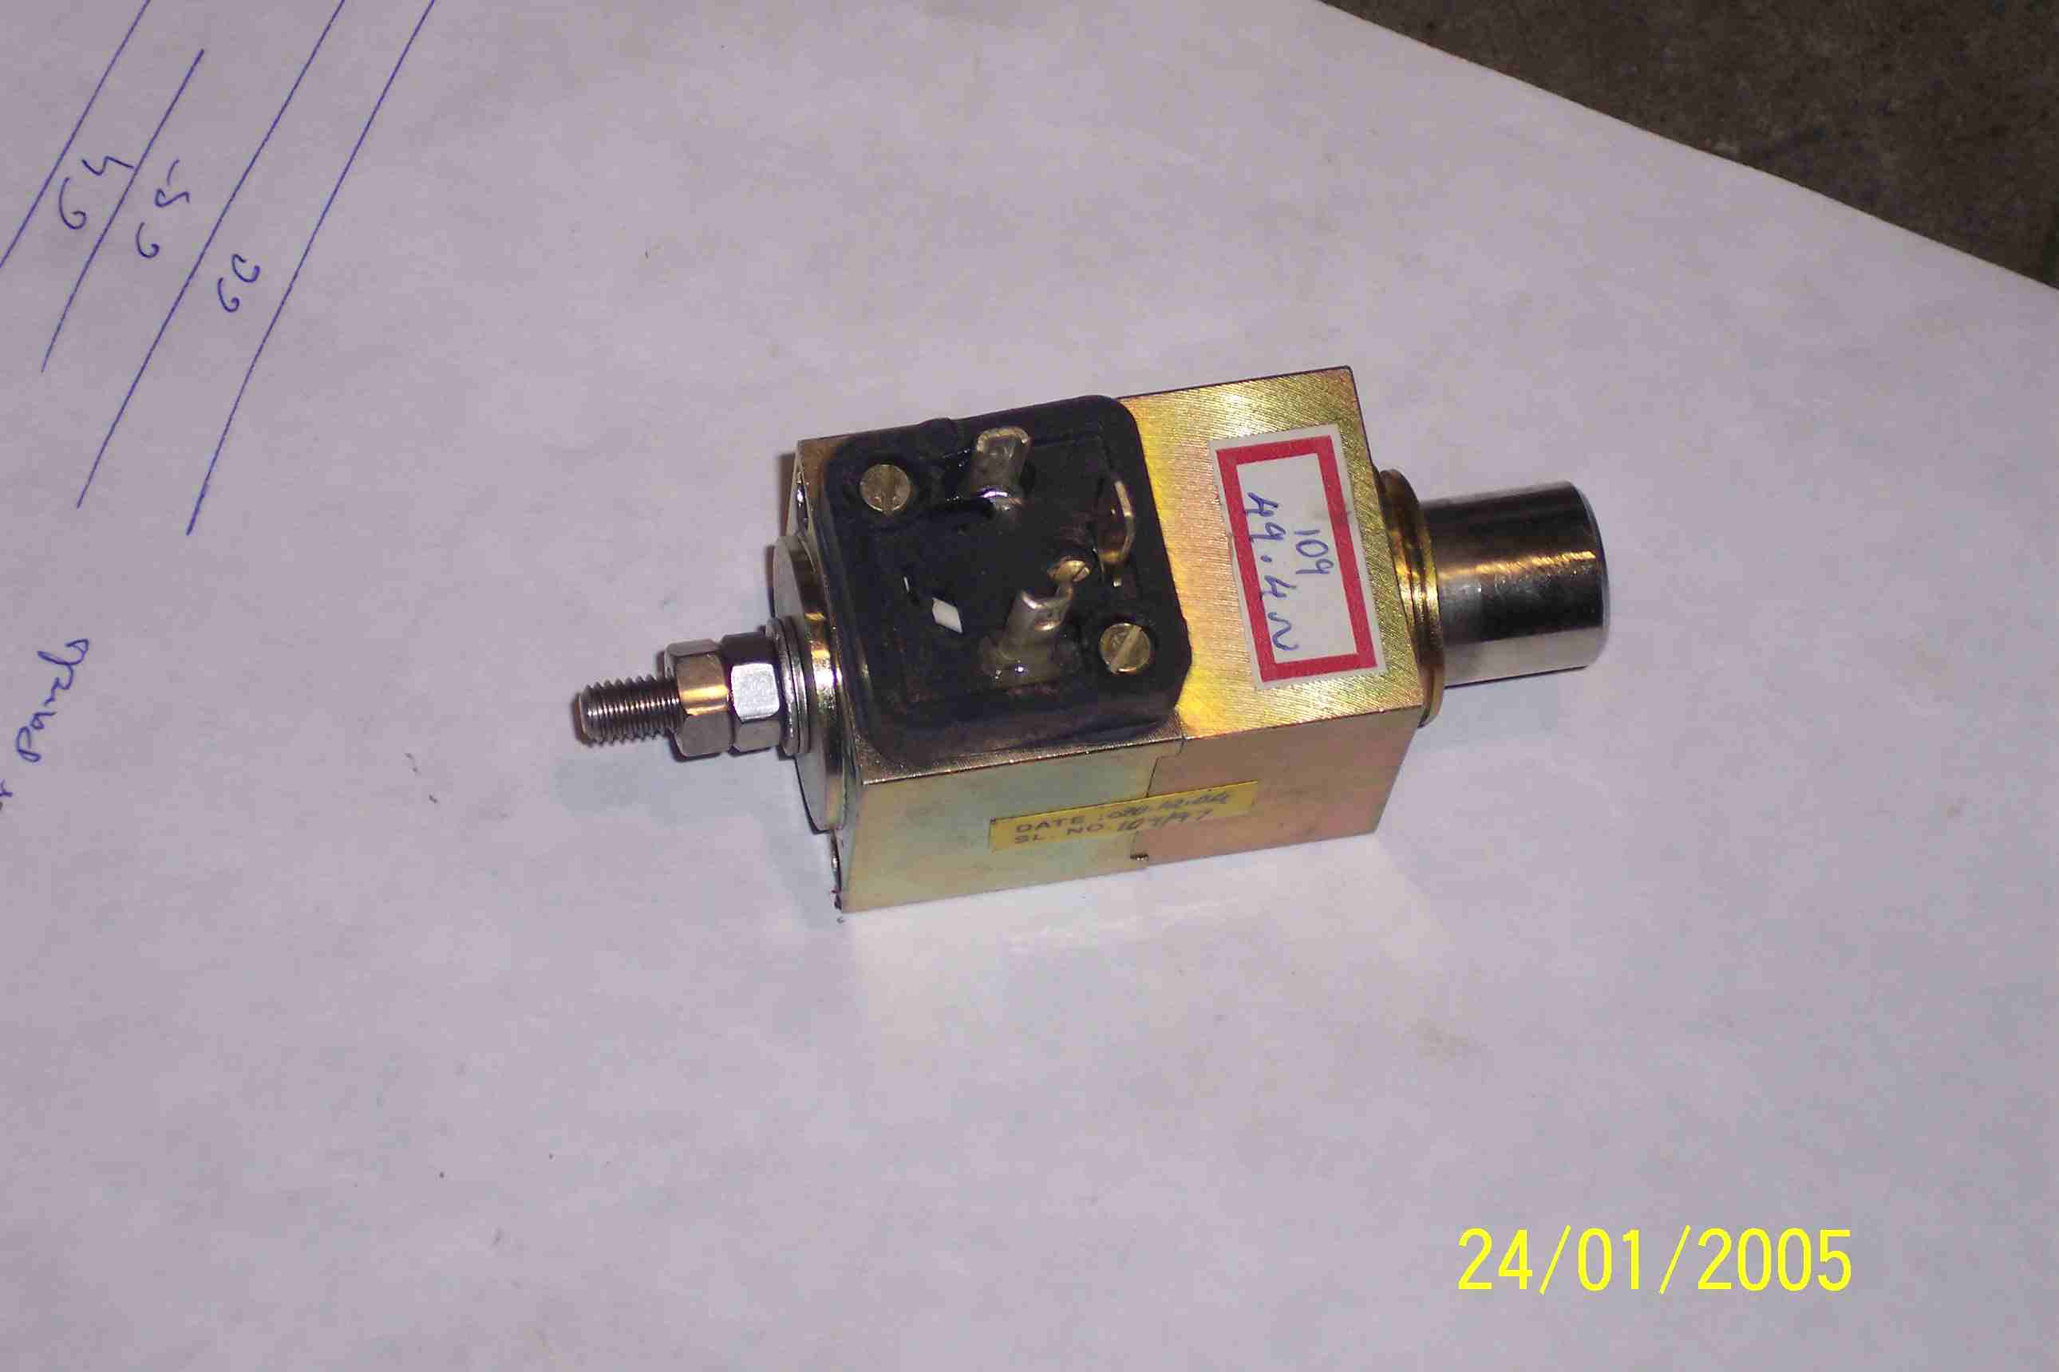
SIEMENS
HVCB SPARES
CLOSING COIL
TRIP COILS
(2 Nos per CB)
Same For 72.5KV, 145KV & 245KV HVCBs
Part No. 110V DC : S4799101001; 220V DC: S4710676005

